Slide 1


LET’S DONATE TIME

Slide 2

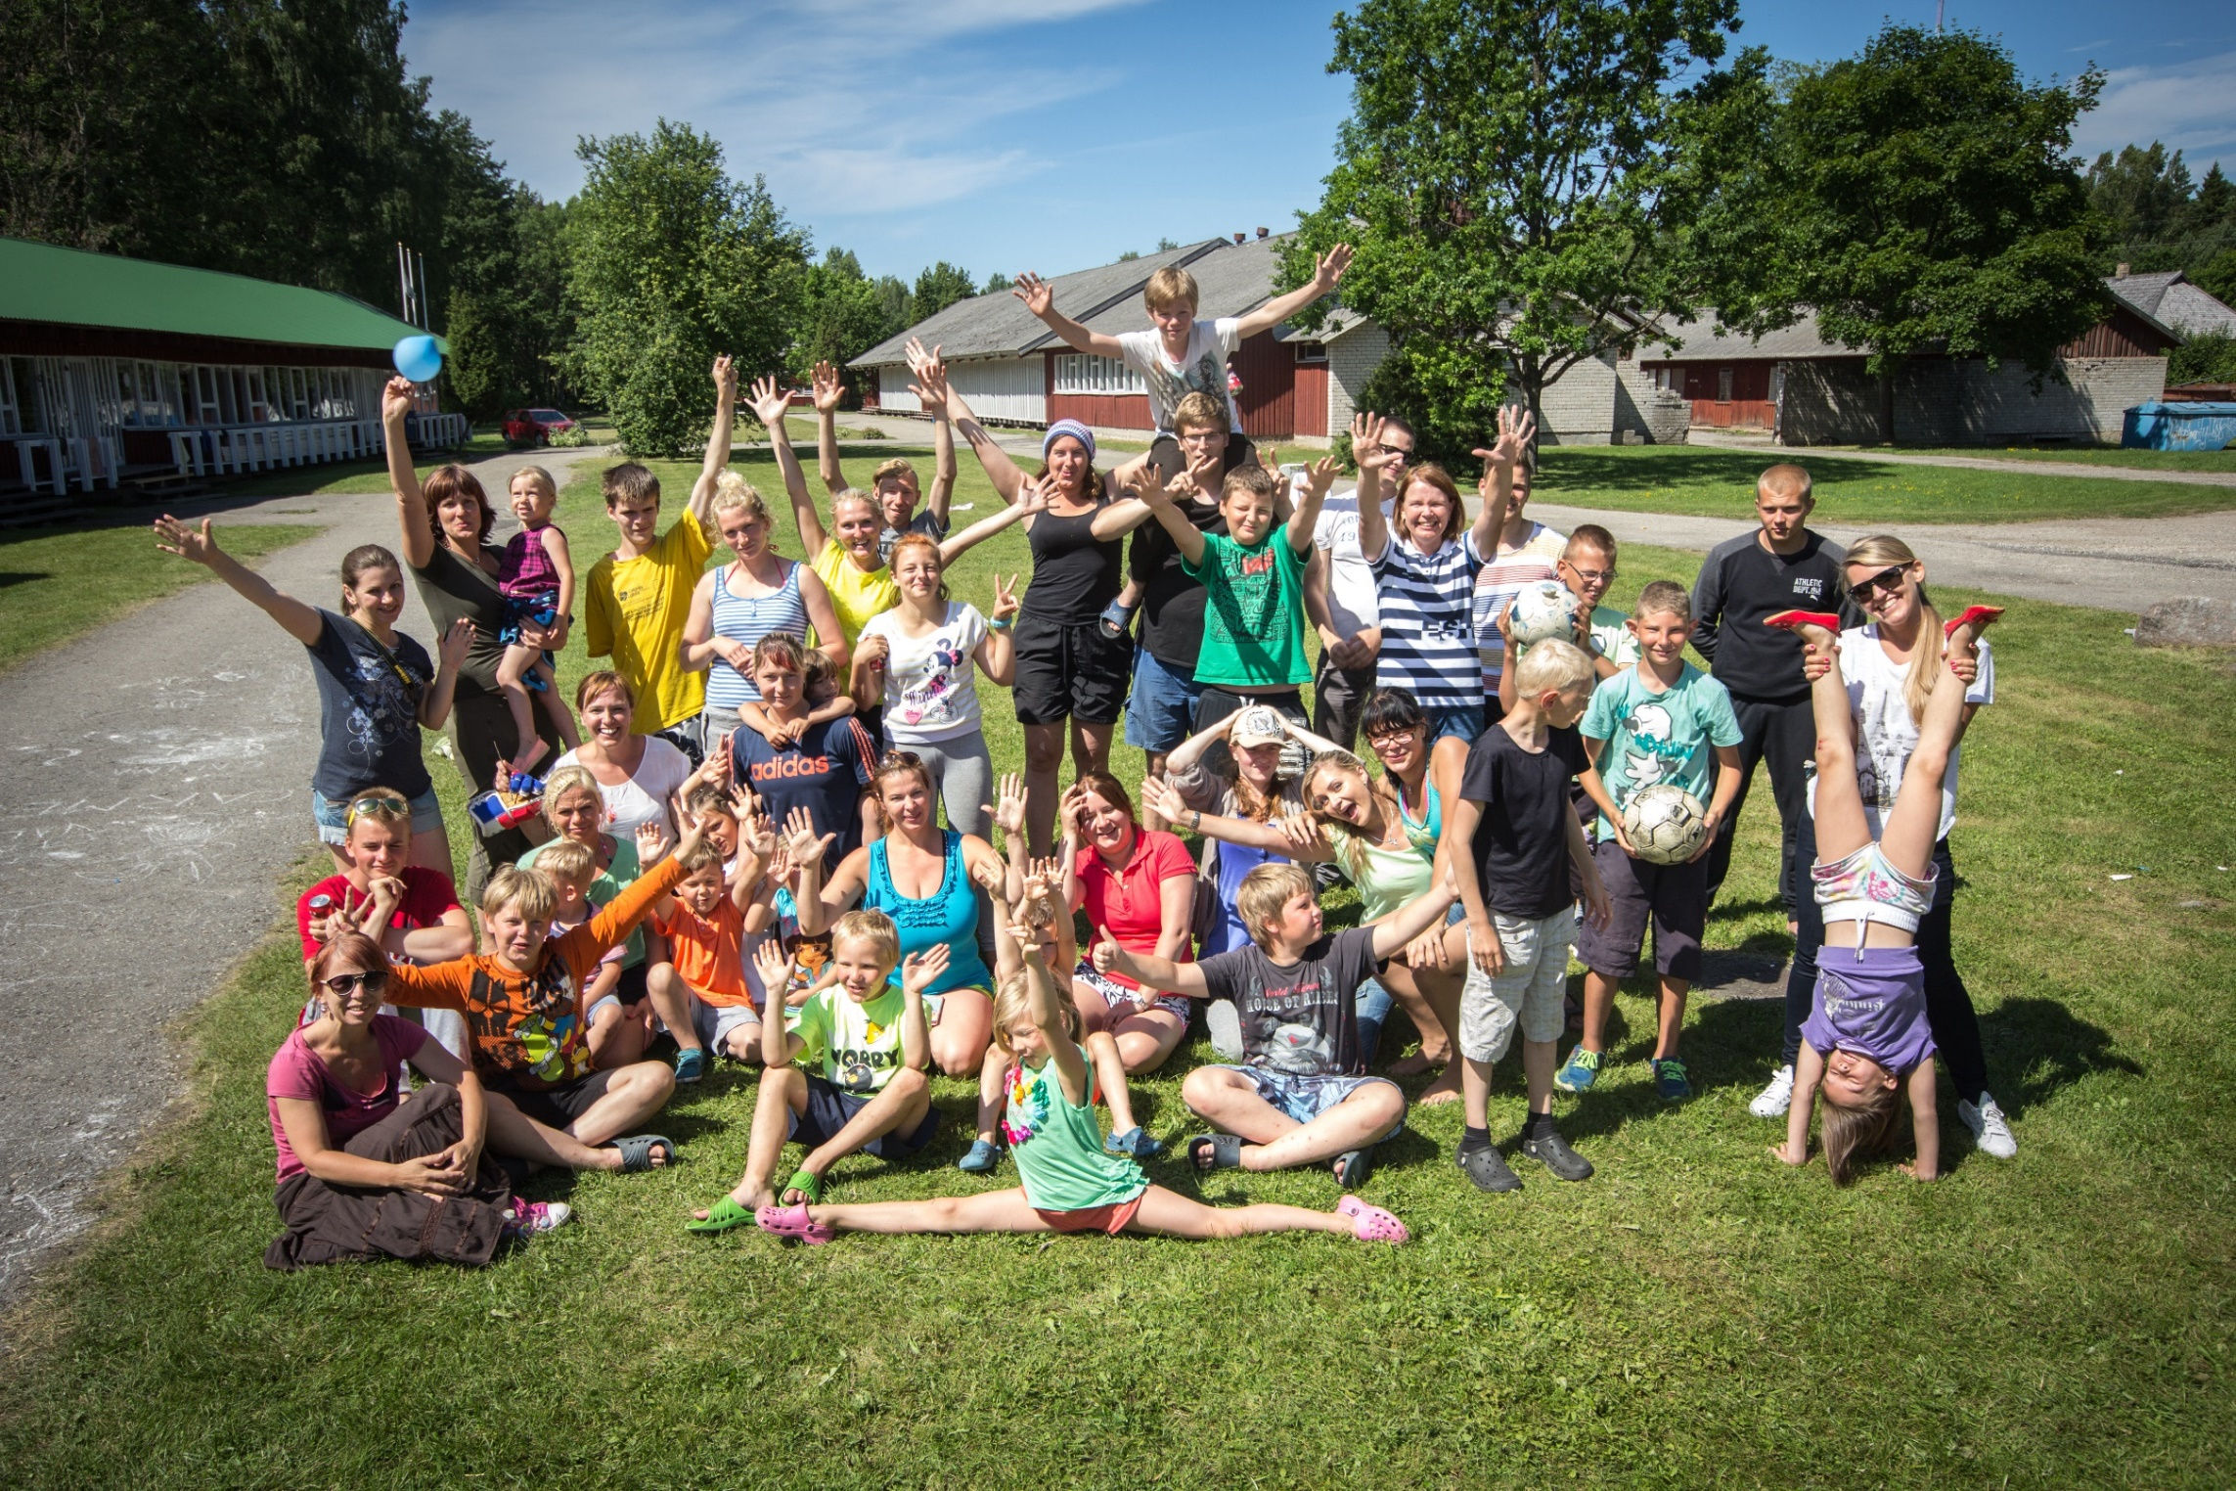
IDEA
Employers give their employees
one paid day off per year
Employees use the day off for doing good in teams
A simple and flexible model for starting a charity or adding to current activities

Slide 3
OBJECTIVE
improve charity culture in Estonia
– donated time may have even higher value for the beneficiary than money
introduce to the public the role of the private sector in society
  – employers as taxpayers maintain the society, but in addition make their contribution even where it is not mandatory
unite varied employers with initiatives throughout Estonia
– charity is not just the preserve of large enterprises; instead, donating time is something that can be accomplished by most employers.

Slide 4
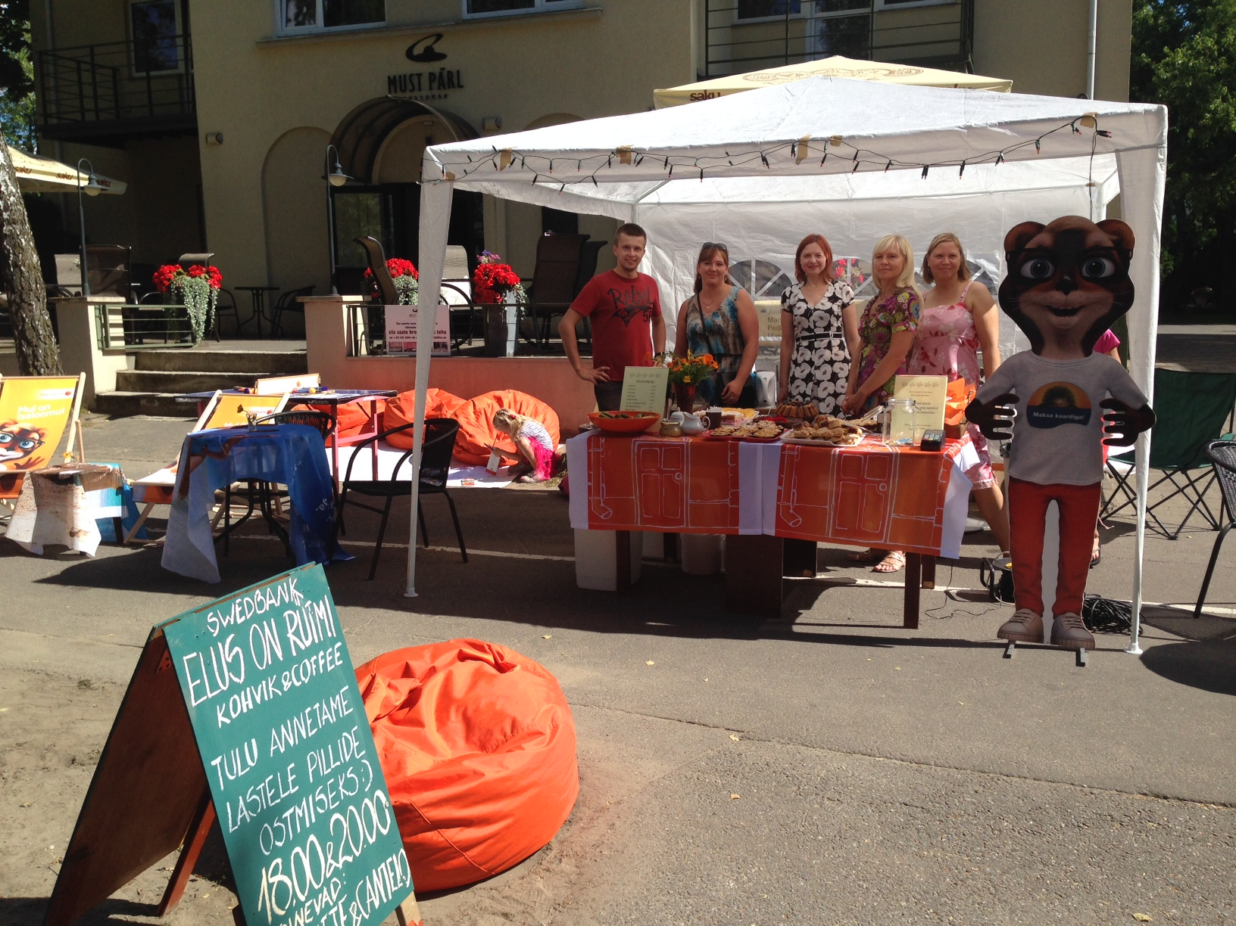
EXPERIENCE OF SWEDBANK
Swedbank tested the concept in 2015. The test was a success and became a tradition.
In the first year, 1100 employees participated in 82 teams (55% of staff).
Most of the teams searched for and found the beneficiaries themselves.

Slide 5
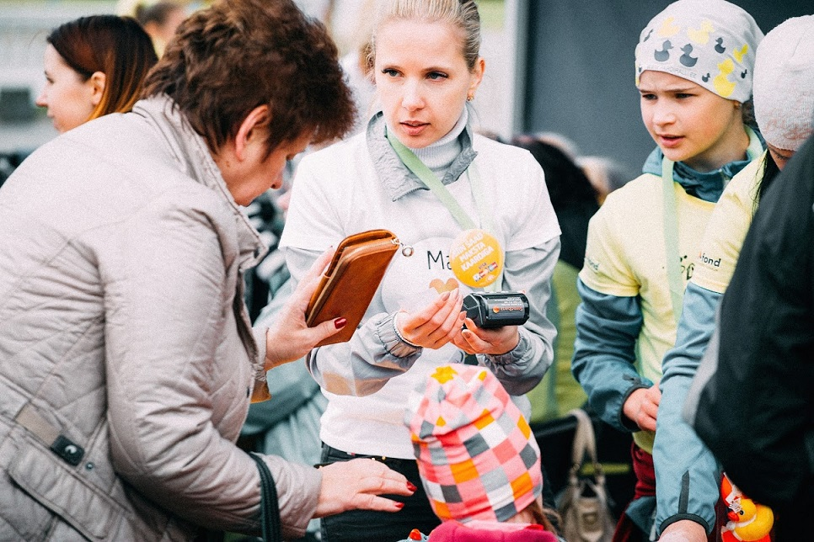
EXPERIENCE OF SWEDBANK
Feedback: 97% of respondents wanted to participate again the next year; 91% got the inspiration to also do good outside the com-pany.
Employees primarily chose areas of charity related to children or maintenance works, but also animals, education and the elderly.

Slide 6
THREE DIFFERENT GOOD DEEDS
Private Banking day at the autism centre
Team “Liivalaia 14/8” fixing up the Maidla village square
Great day with kids from Haiba children's home

Slide 7
WHY JOIN THE INITIATIVE?
Provides a handy model for starting with charity work in the organisation
Possibility to develop teams and increase the commitment of staff
Increases responsibility of staff and develops initiative
Possibility to introduce the company to customers as well as potential staff (employer’s branding)
Do good and feel good about it

Slide 8
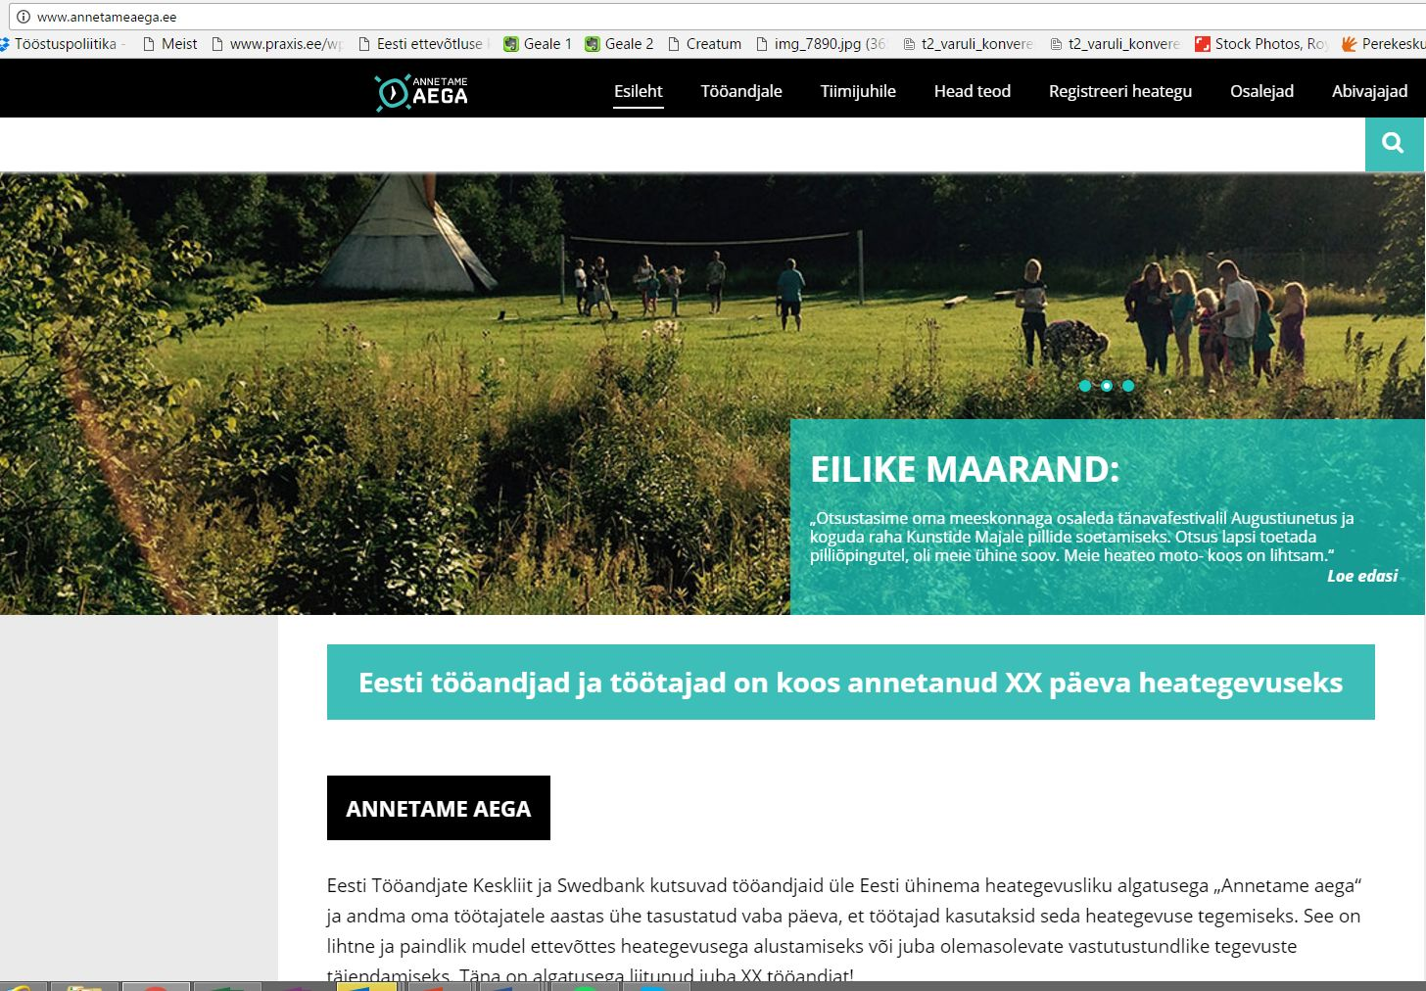
PARTICIPATION IS EASY
There is no need to reinvent the wheel, since
The Estonian Employers' Confederation supports:
webpage www.annetameaega.ee
introducing the participants and good deeds to the public
central communication
help in case of problems and questions
exchanging of experiences
inspiration list of beneficiaries
internal communication
etc.

Slide 9
HOW TO JOIN?
The conditions are very simple and flexible:
1) The employer gives its employees one day off per year
2) The employees can decide to whom they donate their time
3) The good deed is registered on the webpage www.annetameaega.ee

Slide 10
WHO CAN BE A BENEFICIARY?
A beneficiary of the good deed may be an individual or organisation
Also, professional volunteering is possible, i.e. helping with professional skills
Activities on behalf of a profitable business related to the employee or their close ones and activities related to politics do not count

Slide 11



WHERE DO YOU FIND BENEFICIARIES?
If the staff needs inspiration:
https://www.armastanaidata.ee/
http://www.servethecity.ee/

Slide 12

ADJUST THE INITIATIVE TO SUIT YOUR
ORGANISATION
A day off can be given at any time of the year
A team may also do good on a weekend or during a national holiday
and the day off will be used later upon agreement with the manager – this way it will be easier to adjust it with the working time calendar
Also, several days off can be granted upon request
There may be one large team instead of several teams (e.g. one common bee day within the entire organisation)
To cover the costs, pocket money or other available resources within
the organisation can be allocated
Traditional time donations by an organisation can also be added to the initiative

Slide 13
Assistance in all matters can be obtained from:
Liisi Maria Muuli phone: 56 21 78 87 e-mail: liisi@employers.ee

